Slide 1
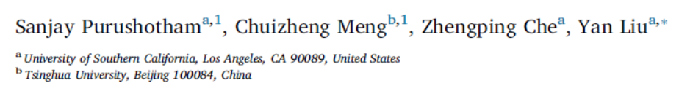
Benchmarking deep learning models on large healthcare datasets

Slide 2

1
Introduction
Present detailed benchmarking results of deep learning models on MIMIC-III dataset for three clinical prediction tasks including mortality prediction, forecasting length of stay, and ICD-9 code group prediction.
Present benchmarking results on different feature sets including ‘processed’ and ‘raw’ clinical timeseries. We show that deep learning models obtain better results on ‘raw’ features which indicates that rule-based preprocessing of clinical features is not necessary for deep learning models.
Deep learning models consistently outperform all the other approaches especially when a large number of raw clinical time series data is used as input features to the prediction models.
Notes:
few works exist which have benchmarked the performance of the deep learning models with
respect to the state-of-the-art machine learning models and prognostic scoring systems on publicly available
healthcare datasets.

Slide 3
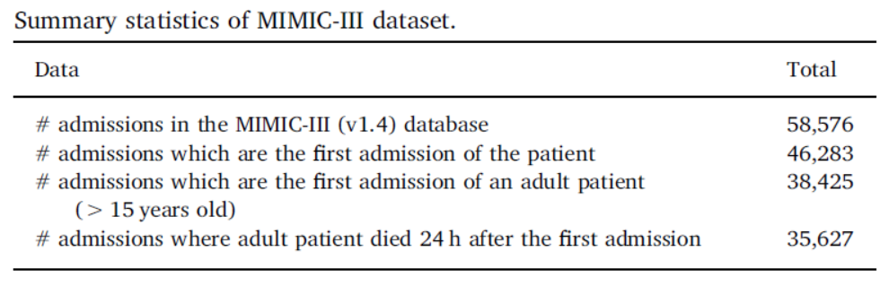
3
Medical Information Mart for Intensive Care III (MIMIC-III) (v1.4)
publicly available critical care database maintained by the Massachusetts Institute of Technology (MIT)’s Laboratory for Computational Physiology.
integrates deidentified, comprehensive clinical data of patients admitted to an Intensive Care Unit (ICU) at the Beth Israel Deaconess Medical Center (BIDMC) in Boston, Massachusetts during 2001 to 2012.
https://physionet.org/content/mimiciii/1.4/
Notes:
To obtain consistent benchmarking datasets, in this paper we only include the first ICU admission of the patients.

Slide 4
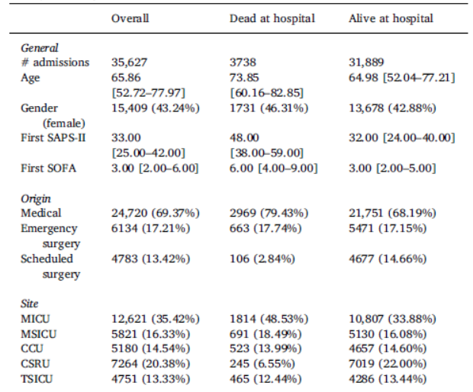
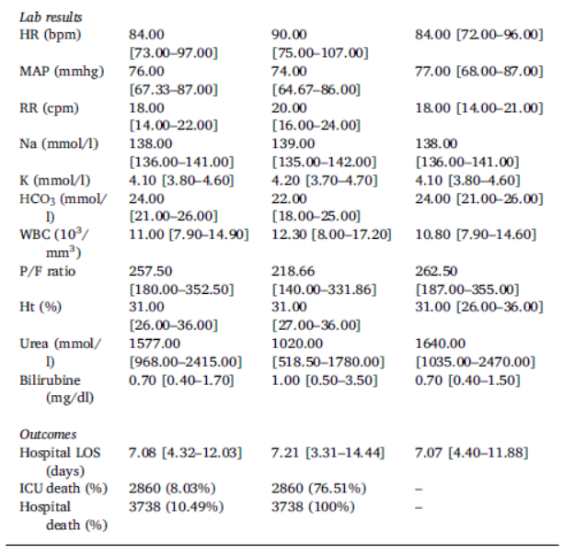
3
Medical Information Mart for Intensive Care III (MIMIC-III) (v1.4)
Notes:
Baseline characteristics and in-hospital mortality outcome measures.
Continuous variables are presented as Median [InterQuartile Range Q1–Q3];
binary or categorical variables as Count (%).

Slide 5
Cohort Selection
Data Extraction
Data Cleaning
Feature Extraction
3
Dataset preprocessing
Notes:
In this section, we describe in detail the cohort selection, data extraction, data cleaning and feature extraction methods we employed to
preprocess our MIMIC-III dataset.

Slide 6
3
Dataset preprocessing
Cohort selection
identified all the adult patients (age > 15 years at the time of ICU admission)
only use their first admission
Data extraction
inputevents (inputevents_cv/inputevents_mv) (intake for patients monitored using Philips CareVue system/iMDSoft MetaVision system)
outputevents (output information for patients while in the ICU)
chartevents (all charted observations for patients)
labevents (laboratory measurements for patients both within the hospital and in outpatient clinics
Prescriptions (medications ordered, and not necessarily administered, for a given patient)
MIMIC-III
MIMIC-III (CareVue) (inputevents data recorded using Philips CareVue system)
Notes:
Charted events such as laboratory tests, doctor notes and fluids into/out of patients are stored in a series of ’events’ tables.
We selected these tables as they provide the most relevant clinical features for the prediction tasks considered in this work. We obtained the following two benchmark datasets.
MIMIC-III (CareVue) is a subset of MIMIC-III dataset and it roughly corresponds to the MIMIC-II dataset.

Slide 7
3
Dataset preprocessing
Data cleaning
Erroneous entries due to noise, missing values, outliers, duplicate or incorrect records, clerical mistakes, etc.
inconsistent units: obtain the percentage of each unit appearing in the database for a variable. If there is only one unit, do nothing. For variables with multiple and inconsistent units, if a major unit accounts for ⩾90% of the total number of records then just keep all the records with the major unit and drop the other ones. For the rest of the variables/features which do not have a major unit, convert all the units to a single unit based on accepted rules in literature
multiple recordings at the same time: For numerical features, take the average of the multiple recordings present at the same time. For categorical features, only keep the value that appears first.
range of feature values: We take the median of the range to represent the value of the feature at a certain time point.
Notes:
For example,some of the prescriptions are recorded in ‘dose’ and in ‘mg’ units; while some variables in chartevents and labevents tables are recorded in both numeric and string data type. Second, some variables have multiple values recorded at the same time. Third, for some variables the observation was recorded as a range rather than a single measurement.

Slide 8
3
Feature selection and extraction
Feature Set A
Processed Features
This feature set consists of the 17 features used in the calculation of the SAPS-II score
Feature Set B
Raw Features
This feature set consists of the 20 features related to the 17 features used in SAPS-II score
Feature Set C
Much More Raw Features
Study if the prediction models can automatically learn feature representations from a large number of raw and obtain better results on the prediction tasks.
Preprocessing time series features and non time series features
This feature set consists of 136 raw features includes the 20 features of Feature set B.
Do not preprocess

Slide 9
3
Feature selection and extraction
Extracted the features from first 24 h and first 48 h after admission to ICU.
Each time series feature is sampled every 1 h.
Aggregate the multiple readings (each hour for Feature C, each day for Feature A and B)
Take the summation of the multiple recordings generally for the fluids or medications into/out of patient, and average for other features.
Forward and backward imputation to fill-in missing values.
Mean imputation for complete missing values.
Notes:
Each time series feature is sampled every 1 h.
For example, in Feature set A, we sum up the urine output feature and
take the average for the other features.

Slide 10
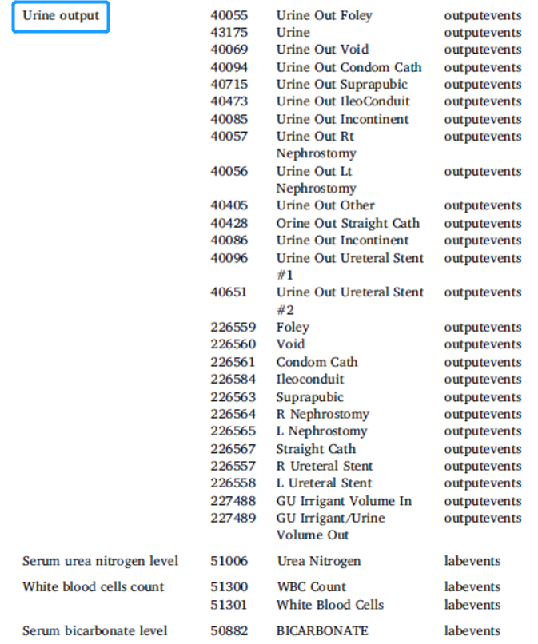
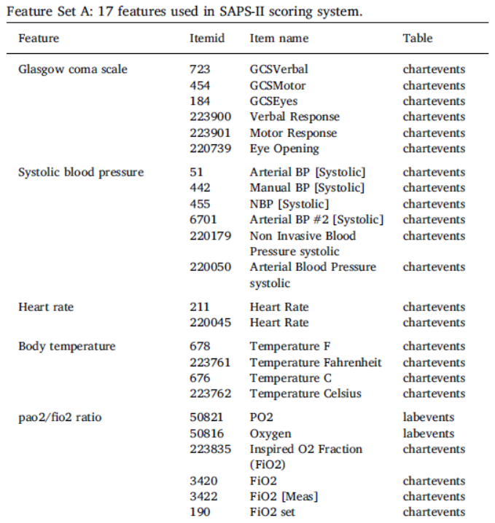
3
Feature selection and extraction

Slide 11
4
Benchmarking experiments
Mortality prediction
In-hospital mortality prediction
Short-term mortality prediction
Long-term mortality prediction
ICD-9 code group prediction
International Statistical Classification of Diseases and Related Health Problems
Nearly every health condition can be assigned a unique ICD-9 code group where each group usually include a set of similar diseases.
Group all the ICD-9 codes for an ICU admission into 20 diagnosis groups and treat this task as a multi-task prediction problem.
Length of stay prediction
Treat length of stay prediction task as a regression problem.
Notes:
We formulate mortality as a binary classification task, where the label indicates the death event for a patient.
Predict whether the patient dies during the hospital stay after admitted to an ICU.
For first 24-h data, we can predict 2-day and 3-day mortality, while for the first 48-h data we only predict 3-day mortality.
For this task, we consider the 30-day and 1-year mortality prediction tasks where the patient dies within 30-days or 1 year after being discharged from the hospital. Note that we still use only the first 24-h data and first 48-h data to predict 30-days and 1-year mortality.

Slide 12
4
Prediction algorithms
Scoring methods
Super Learner Models
Deep Learning Models

Slide 13
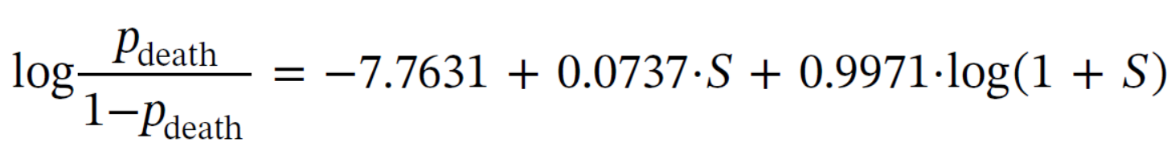
4
Prediction algorithms
Scoring methods
SAPS-II (Simplified Acute Physiology Score)
SOFA (Sepsis-related Organ Failure Assessment score)
New SAPS-II
Notes:
it is a ICU scoring system designed to measure the severity of the disease for patients admitted to an ICU. A point score is calculated for each of the 12 physiological features (mentioned in Table 4) and a final SAPS-II score S is obtained as the sum of all point scores.
it is used to describe organ dysfunction/failure of a patient in the ICU. The mortality prediction based on SOFA can be obtained by
regressing the mortality on the SOFA score using a main-term logistic regression model.
It is a modified version of SAPS-II and is obtained by fitting a main-term logistic regression model using the same explanatory variables as those used in the original SAPS-II score calculation.

Slide 14
4
Prediction algorithms
Super Learner models
a supervised learning algorithm designed to find the optimal combination from a set of prediction algorithms.
It represents an asymptotically optimal learning system and is built on the theory of cross-validation.
This algorithm requires a collection of user-defined machine learning algorithms such as logistic regression, regression trees, additive models, (shallow) neural networks, and random forest.
To reduce variability, multiple rounds of cross-validation are performed using different partitions, and the validation results are averaged over the rounds.
Super Learner builds an aggregate algorithm obtained as the optimal weighted combination of the candidate algorithms.

Slide 15
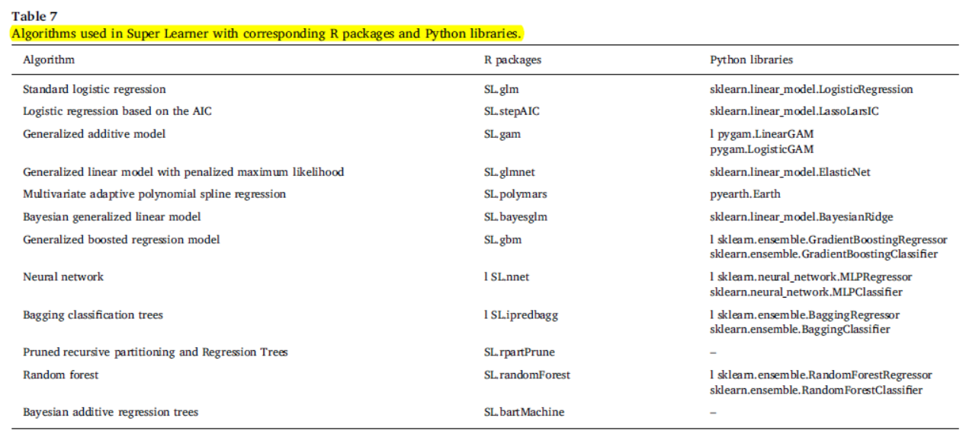
4
Prediction algorithms
Super Learner models

Slide 16
4
Prediction algorithms Implementation details
Super Learner Models
Default parameters (as listed in their R package) for each base algorithm in the Super Learner algorithm since
Notes:
we found through grid search that the performance did not vary much with fine-tuning of base algorithms with different parameter settings
Related work [30] which proposed SuperLearner algorithm for mortality prediction also used the default parameters to obtain their results.

Slide 17
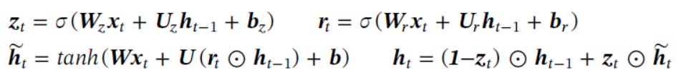
4
Prediction algorithms
Neural Networks
Feedforward Neural Networks (FNN)
Recurrent neural network (RNN): GRU
Propose a deep learning framework called as Multimodal Deep Learning Model (MMDL) to learn shared representations from multiple modalities using an ensemble of FFN and GRU deep learning models.
Notes:
We optimize the crossentropy or mean squared error prediction loss for classification or regression tasks respectively and get the prediction output from the topmost prediction layer.
The update function of GRU is shown as follows:
datasets come from multiple tables and includes both temporal and non-temporal data, multimodal deep learning models can be used to shared learn representations for the prediction tasks

Slide 18
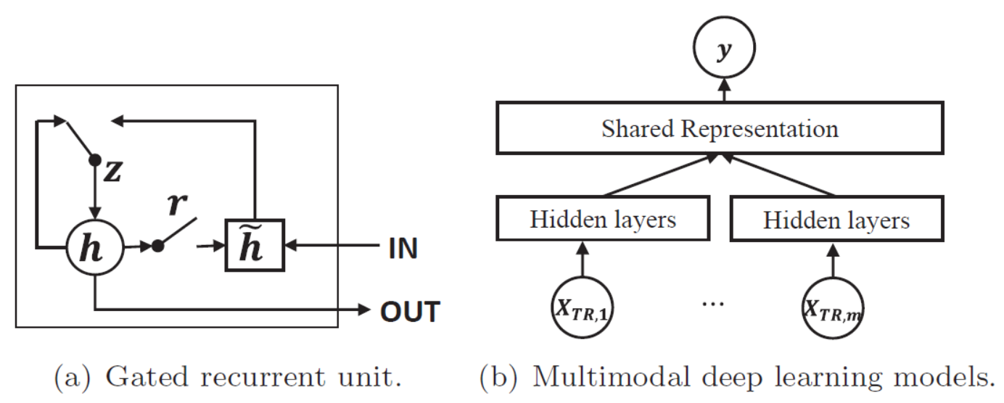
4
Prediction algorithms
Neural Networks
Propose a deep learning framework called as Multimodal Deep Learning Model (MMDL) to learn shared representations from multiple modalities using an ensemble of FFN and GRU deep learning models.
The key idea is to use a shared representation layer to capture the correlations of modalities or to learn a similarity of modalities in representation space, which is beneficial when limited data is available from multiple modalities.
Treat all the temporal features as one modality and all non-temporal features as another modality.
Notes:
Deep learning models. In multimodal deep models, X(.) represents the different inputs including temporal and non-temporal features, and y is the output
Data from each of the different tables can be treated as a separate modality. For simplicity, in MMDL, we

Slide 19
4
Prediction algorithms
Neural Networks
MMDL uses FFN and GRU to handle non-temporal and temporal features respectively, and learns their shared latent representations for prediction tasks.
The non-temporal data is fed into FFN
The Temporal data is input to GRU
The outputs of the FFN and GRU are combined in a shared latent representation layer.
Notes:
Deep learning models. In multimodal deep models, X(.) represents the different inputs including temporal and non-temporal features, and y is the output
Data from each of the different tables can be treated as a separate modality. For simplicity, in MMDL, we

Slide 20
4
Prediction algorithms Implementation details
Neural Networks
5-fold cross validation(by training on three folds, validation on one fold and report results on the remaining fold)
Area under the ROC curve (AUROC) and Area under Precision-Recall Curve (AUPRC) as the evaluation metrics to report the prediction model’s performance on classification tasks
Mean Squared Error (MSE) to report results on the regression task
RMSProp optimizer method with learning rate of 0.001 on classification tasks and 0.005 on regression tasks.
ReLU activation
dropout rate set to 0.1 to all the deep
learning models to avoid overfitting
batch size is 100 and the max epoch number is fixed at 250
Early stopping with best weight and batch normalization
Notes:
ReLU for all models since it is shown to achieve good performance in many classification tasks.
We also applied dropout with dropout rate set to 0.1 to all the deep learning models to avoid overfitting

Slide 21
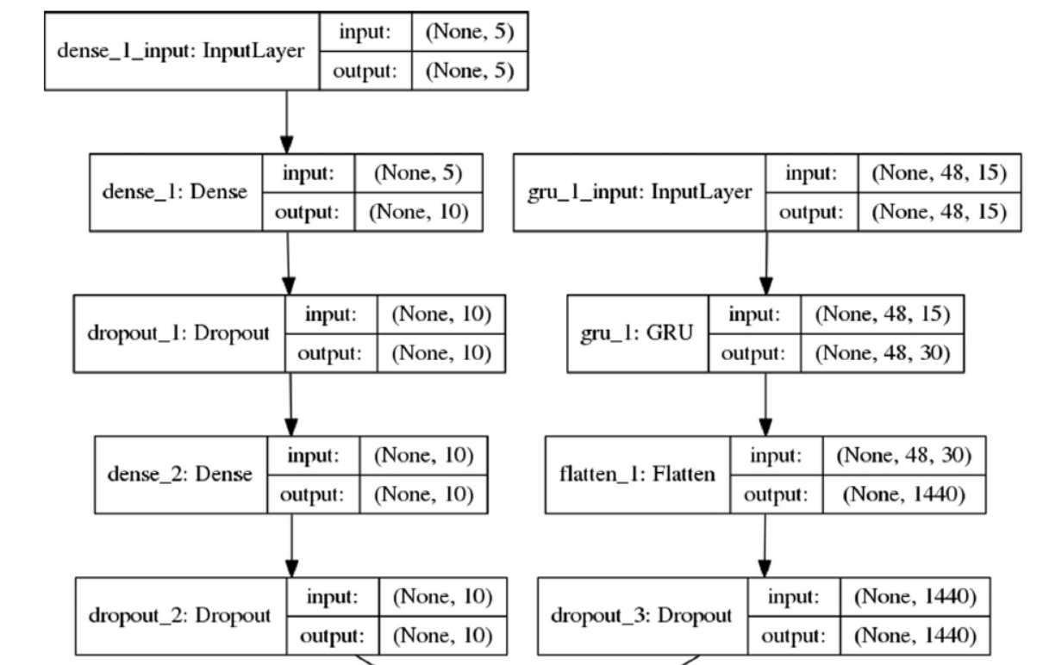
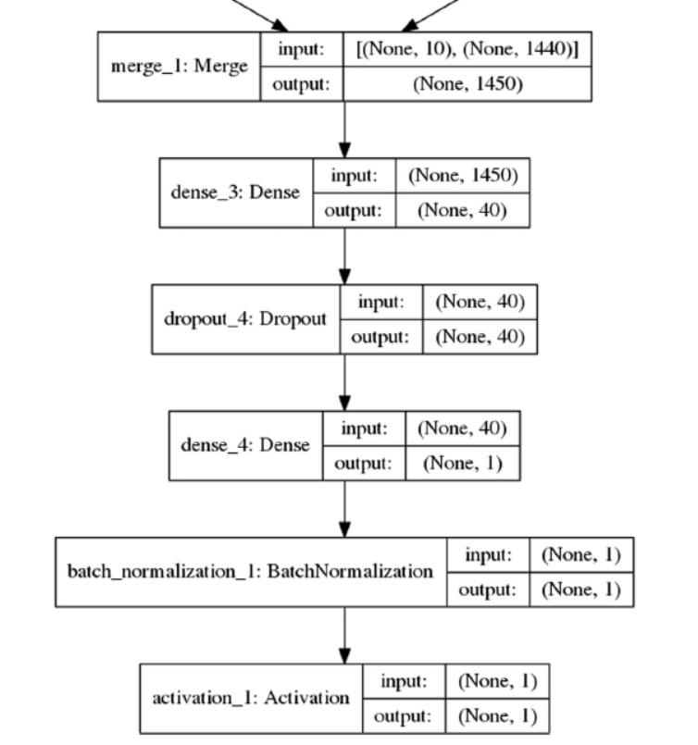
4
Prediction algorithms Implementation details
https://github.com/USC-Melady/Benchmarking_DL_MIMICIII
Notes:
Structure of the MMDL model with Feature Set B as input. Non-temporal features are fed to the feed forward network starting from “dense_1_input”, and temporal features are fed to the RNN network starting from “gru_1_input” in the form of 2-D matrices (number of time steps X number of features). The word “None” in the figure refers to the batch size when training the deep learning models, which is 100 in our experiments. Numbers except “None” in one tuple describe the shape of the input/output tensor.

Slide 22
4
Results
How do the Deep Learning models compare to the Super Learner algorithm and scoring systems?
What is the performance of prediction methods on the different feature sets?
Feature Set A
Processed Features
Feature Set B
Raw Features
Feature Set C
Much More Raw Features

Slide 23
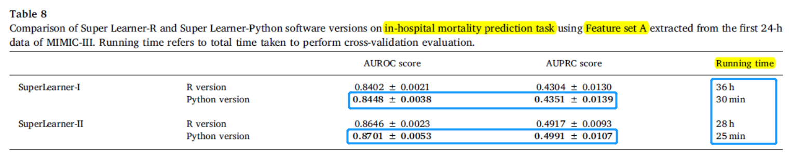
4
Super Learner models Results
Super Learner-Python performs slightly better than Super Leaner-R implementation.
Super Learner-Python can be evaluated significantly faster than Super Learner-R.
Super Learner I: Super Learner with categorized variables
Super Learner II: Super Learner with non-transformed variables.
Super Learner-I is applicable only for Feature set A, while Super Learner-II algorithm can be used with all the Feature sets A, B and C.
Notes:
Thus, in the following experiments, we will only report the results of Super Learner-Python version (unless otherwise stated) to evaluate and benchmark Super Learner algorithm on different tasks.

Slide 24
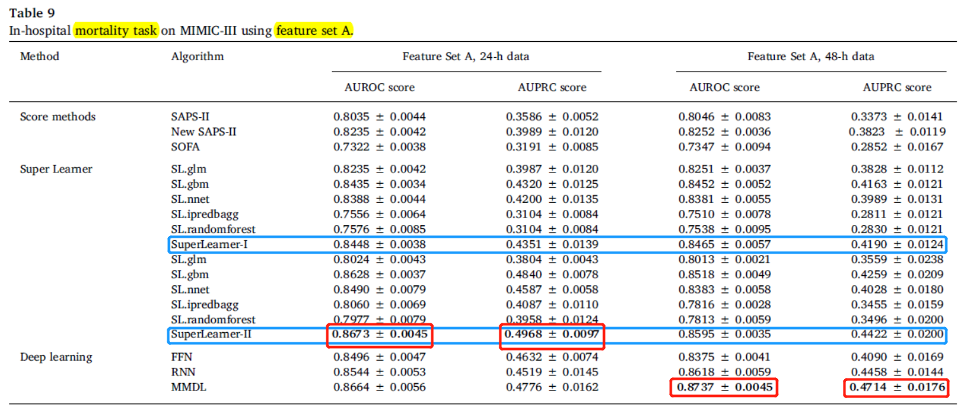
4
In-hospital mortality task on MIMIC-III using feature set A
On 48-h data, deep learning models perform better than all the other models. On 24-h data, Super Learner II model obtains slightly better results than deep learning model.
Notes:
In-hospital mortality task on MIMIC-III (Carvue) using feature set A.

Slide 25
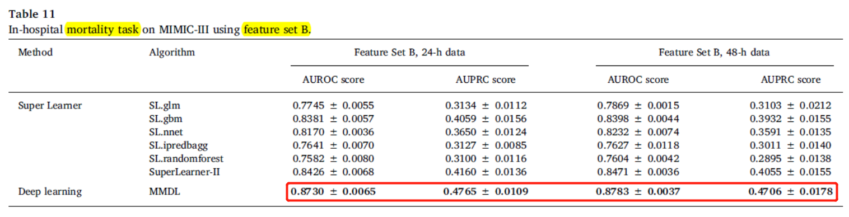
4
In-hospital mortality prediction task results on Features set B and C of MIMIC-III and MIMIC-III (CareVue)
(i) Super Learner performs better than all algorithms used in SuperLearner library.
(ii) On both the Feature Set B and Feature Set C, the deep learning model (MMDL) obtains the best results in terms of AUROC and AUPRC score.
(iii) A longer record length helps little on the in-hospital mortality prediction task.
Notes:
the results on first 48-h data are similar with those on first 24-h data.
I will not show the result of the MIMIC-III (CareVue) because the conclusions are the same.

Slide 26
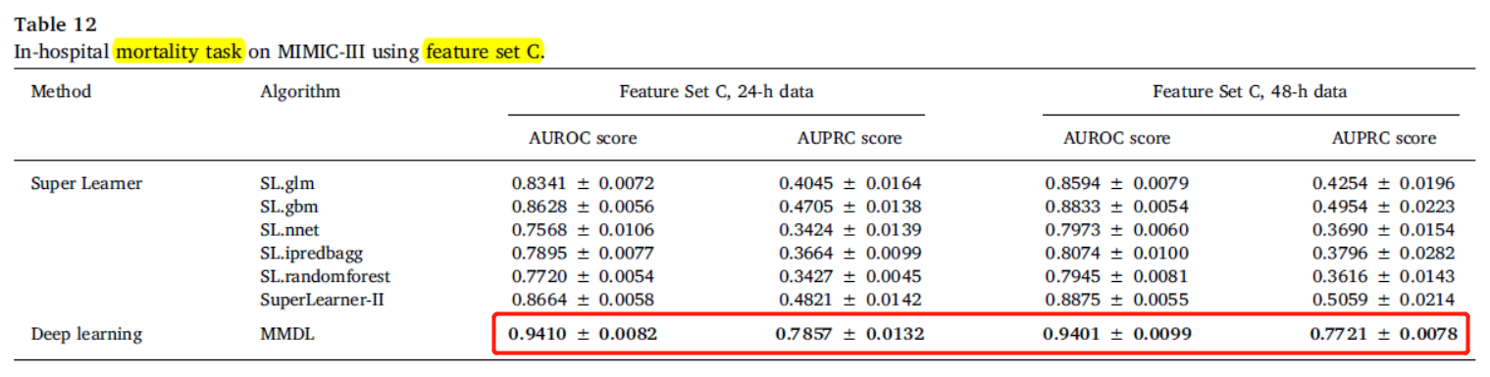
4
In-hospital mortality prediction task results on Features set B and C of MIMIC-III and MIMIC-III (CareVue)
Notes:
the results on first 48-h data are similar with those on first 24-h data.
I will not show the result of the MIMIC-III (CareVue) because the conclusions are the same.

Slide 27
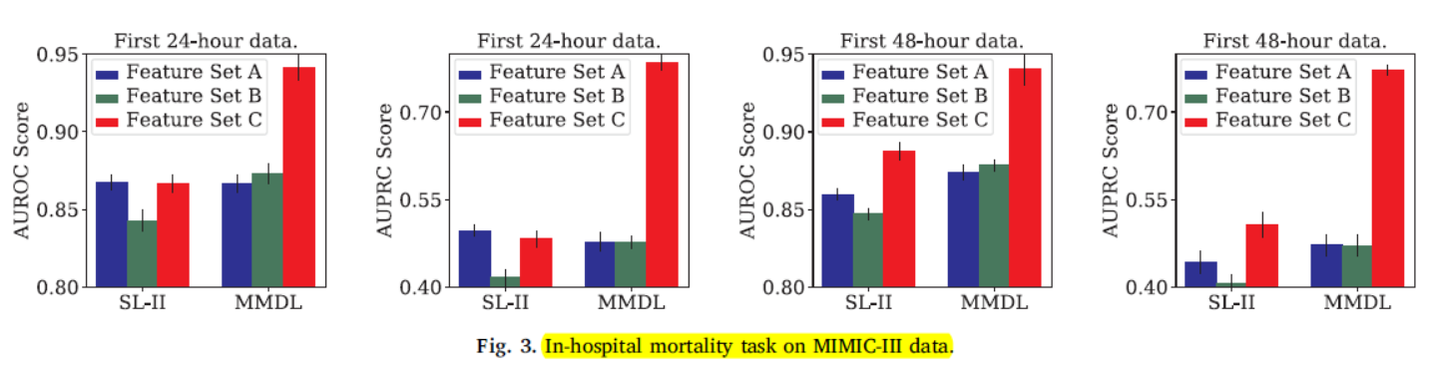
4
In-hospital mortality prediction task
Deep models can learn better feature representations from multiple data modalities (instead of using handpicked features as in Feature Set A)
(i) Deep learning models (MMDL) outperform all the other models when the raw features (Feature set B and C) are used for evaluation
(ii) All the models perform much better when more features are used for prediction.
Notes:
models perform better on Feature set C which has 136 raw features compared to Feature Set B which has 20 features.
From these figues, we see that on Feature set C, deep learning models obtain around 7–8% and 50% improvement over SuperLearner models for AUROC and AUPRC respectively.
Also, deep learning models obtain 8% improvement for Feature set C compared to Feature set A.

Slide 28
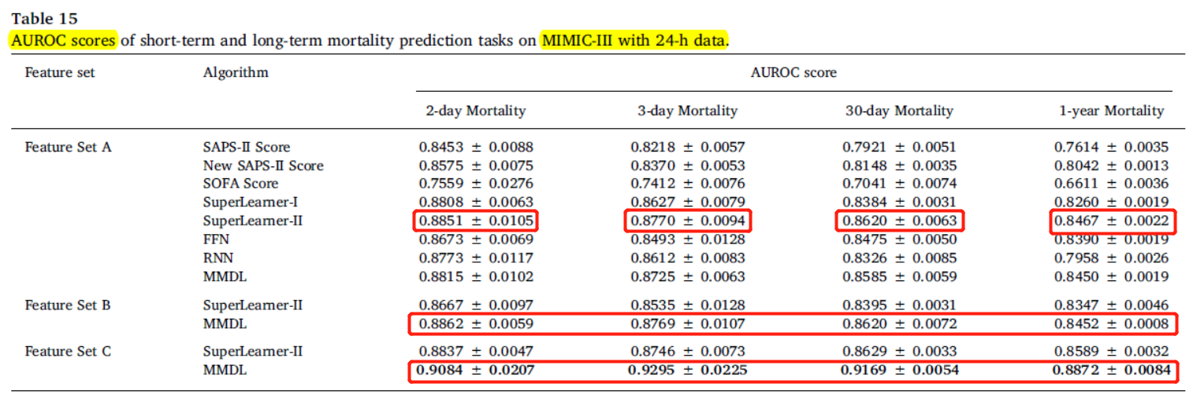
4
Short-term and Long-term Mortality Prediction
On both the Feature Set B and Feature Set C, the MMDL deep learning model consistently obtains the best results in terms of AUROC and AUPRC score
All models obtain better AUPRC scores on the long-term mortality prediction task compared to the short-term mortality prediction task.
Notes:
(i) Super Learner-II and MMDL deep learning models have similar performance on the Feature Set A for both short-term and long-term mortality prediction, and both these algorithms perform better than all other prediction algorithms

Slide 29
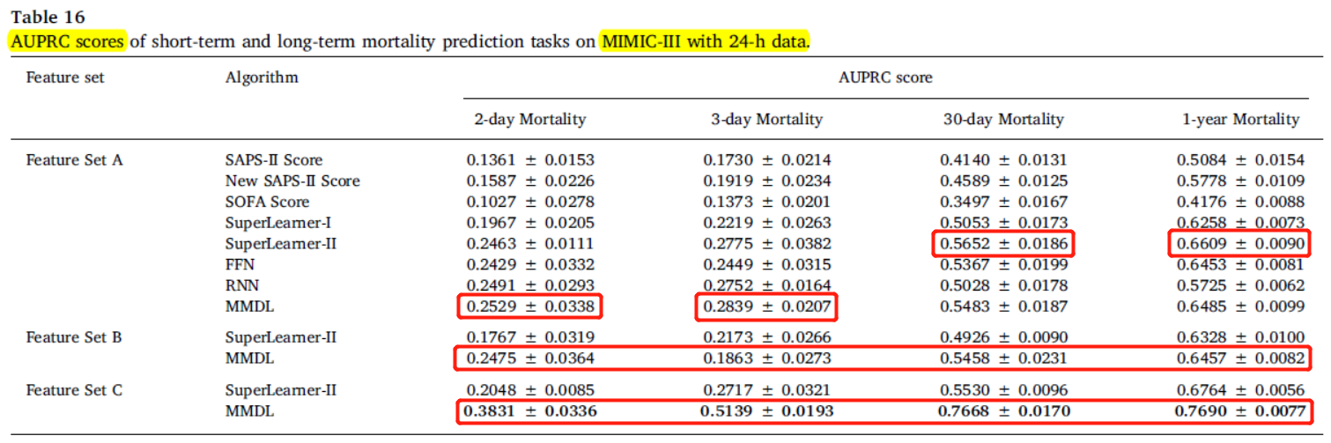
4
Short-term and Long-term Mortality Prediction
On both the Feature Set B and Feature Set C, the MMDL deep learning model consistently obtains the best results in terms of AUROC and AUPRC score
All models obtain better AUPRC scores on the long-term mortality prediction task compared to the short-term mortality prediction task.
Notes:
Super Learner-II and MMDL deep learning models have similar performance on the Feature Set A for both short-term and long-term mortality prediction, and both these algorithms perform better than all other prediction algorithms
Don’t show MIMIC-III with 48-h data results.

Slide 30
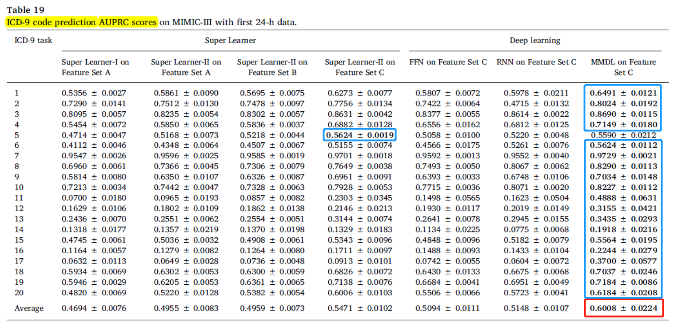
4
ICD-9 code prediction task evaluation
MMDL deep models trained on Feature Set C outperforms Super Learner models on almost all the ICD-9 Code prediction task, and on an average obtains 4–5% improvement.
Notes:
model performs similar or slightly worse than SuperLearner algorithms on two out of 20 ICD-9 tasks (task 11 and 19) as shown in
Table 20 (as measured by AUROC score) and one out of 20 ICD-9 tasks (task 5) as shown in Table 19 (as measured by AUPRC score), because these tasks have smaller number of data points.

Slide 31
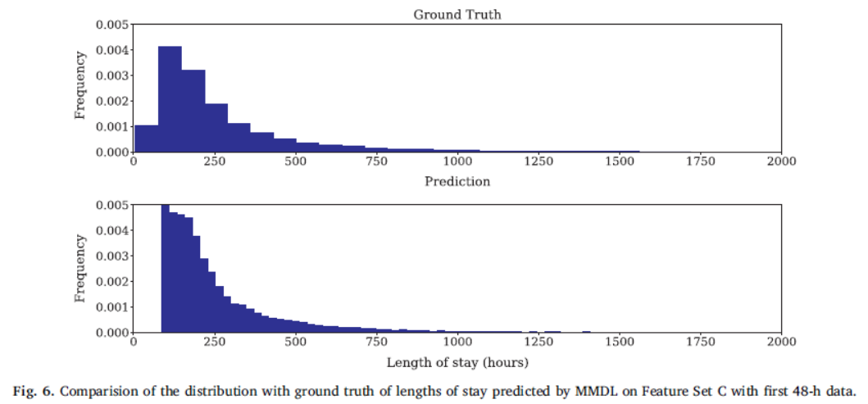
4
Length of stay prediction task evaluation
All deep learning models such as FFN, RRN and MMDL trained on Feature set C outperform Super Learner models trained on Feature sets A,B, and C.
MMDL model obtains best performance in terms of mean squared error (in hours), and significantly outperforms Super Learner II by nearly 50%.
Notes:
Groundtruth (i.e. actual length of stay)
These plots show that our MMDL models predict the Length of stay quite accurately and in-fact our models’ predictions are within 7.5–8.2 days of ground-truth for Feature set C.

Slide 32
5
Summary
Deep learning model (MMDL) mostly outperforms the Super Learner on all the tasks (Mortality, Length of Stay and ICD-9 prediction).
Deep learning models consistently outperform all the other approaches especially when a large number of raw clinical time series data is used as input features to the prediction models.
The main advantage of the deep learning approach is its ability to automatically learn good feature representations from raw data, and thus significantly reduce the effort of handcrafted feature engineering.

